Slide 1
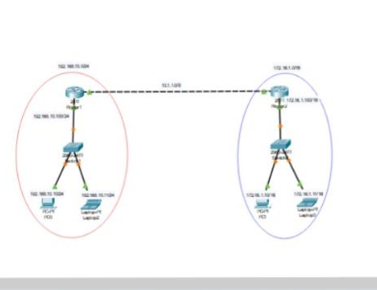
2Router static configuration -----------------------------------
Steps to Configure and Setup clan configuration in Cisco Packet Tracer : Step 1: First, open the cisco packet tracer desktop and select the devices. Step2-Add 4pc , 2routerAND 2 SWITCHES . Ste3-Add automatically wire to pc to switch and router. Step4-Add there ip address on pc .click on pc go to ipcomfigand enter ip adress and subnetmask .

Slide 2
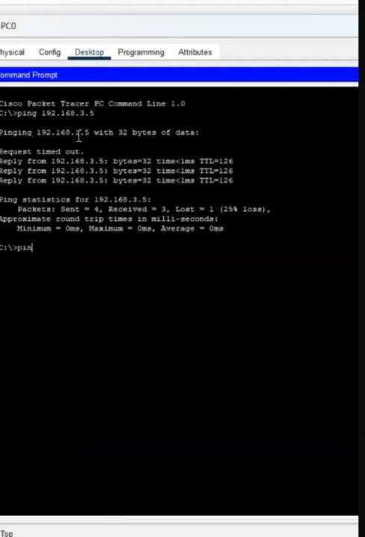
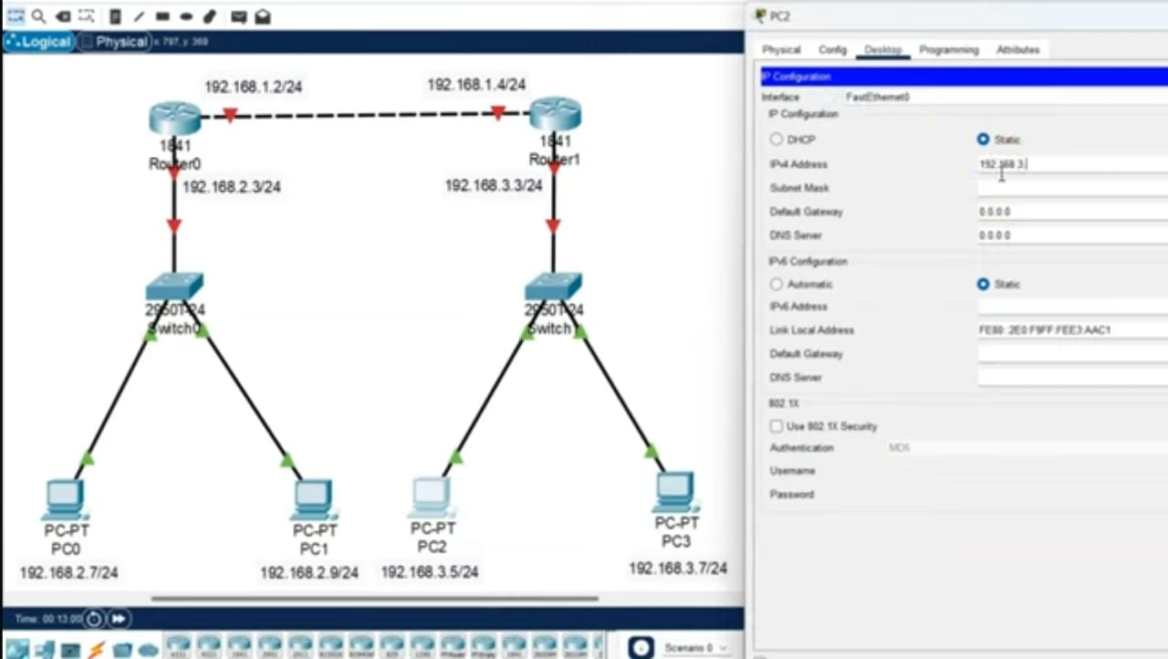
•Go to command types ping (ipaddress
•Now we have to go to switches cli and type commands.

Slide 3
Router R2 config: Router>en Router#conf t Router(config)#hostname R2 R2(config)#interface fa0/1 R2(config-if)#ip add 112.1.1.2 255.255.255.252 R2(config-if)#no shut R2(config-if)#exit R2(config)#interface fa0/0 R2(config-if)#ip add 192.168.20.100 255.255.255.0 R2(config-if)#no shut R2(config-if)#exit R2(config)#int fa1/0 R2(config-if)#ip add 113.1.1.1 255.255.255.252 R2(config-if)#no shut R2(config-if)#exit R2(config)#^Z R2#wr Building configuration... [OK] R2# %LINEPROTO-5-UPDOWN: Line protocol on Interface FastEthernet1/0, changed state to up
Router R1 configuration: Router>enable Router#conf t Router(config)#hostname R1 R1(config)#interface fastEthernet 0/0 R1(config-if)#ip address 192.168.10.100 255.255.255.0 R1(config-if)#no shutdown R1(config-if)#exit R1(config)#interface fastEthernet 0/1 R1(config-if)#ip address 112.1.1.1 255.255.255.252 R1(config-if)#no shut R1(config-if)#^Z R1#wr Building configurAtion
ok

Slide 4
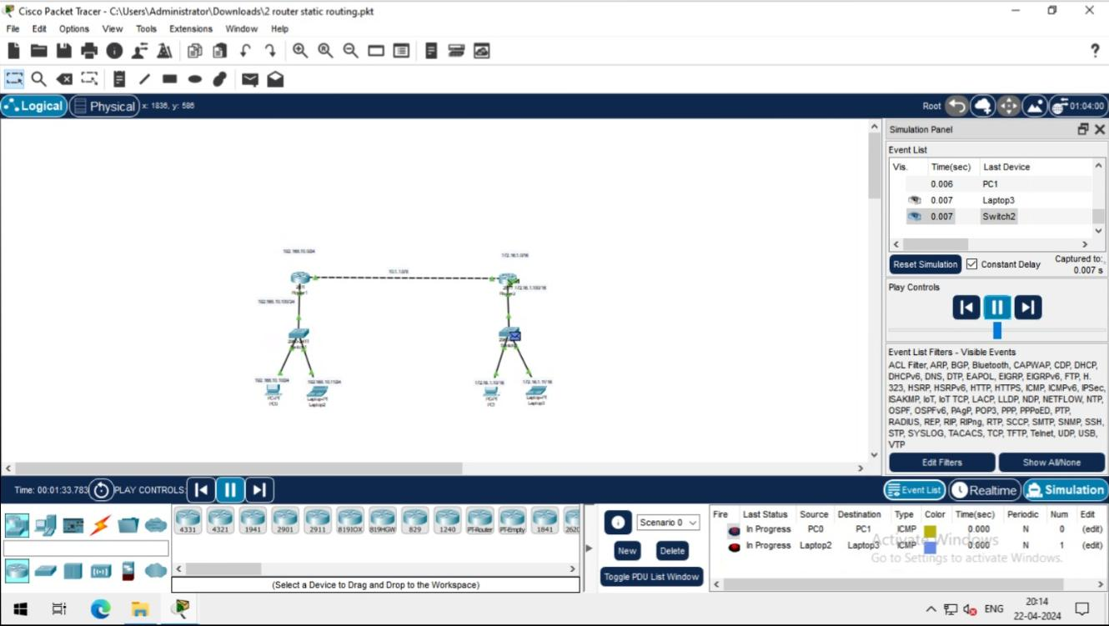
After colplethe confuguratpart then go to ping the pc to router or pc.

